Slide 1

Understanding
the Foster Care
To
Prison Pipeline
DEO110 – FINAL GROUP PROJECT
RUSHELLE PHILLIPS
DOUGLAS A. BELL
RACHEL KORMAN

Slide 2

Rachel Korman
Background
Studied and Graduated from Massage Therapy School
Attended school for a period to gain esthetician skills
Currently working in the Customer Service Field
Studying Data Science Through Entity Academy

Slide 3
Douglas A. Bell
Background
Has an Associates Degree in Liberal Arts
Worked as a Subcontractor with HackBarth delivering medicine to hospitals and clinics
Currently working for CVS as a shift Supervisor
On the path to receive certificate in Data Science through Woz-U
Loves working with numbers and finding correlations between them

Slide 4
Rushelle Phillips
Background
I worked for about 16 years as an administrative assistant on a contract basis with various companies.
I received my Associates of Science in Paralegal Studies
I transitioned to working from home in customer service which has moved into the travel and hospitality field for the past 8 years.
I am now attending Woz-u through Entity Academy for Data Science so that I can have a better life for myself and my 2 children.

Slide 5


Project Introduction
The purpose of this project is to analyze and get a better understanding of the Foster Care to Prison Pipeline and to determine if there is any correlation between children leaving foster care and juvenile incarceration rates.
This project also aims to bring awareness of how informed the public is on the issue of Foster Care and it’s affects on the need for children within the system to have what is necessary to flourish in society without being neglected or falling through the cracks once they age out of the system.

Slide 6

Project Background
In the United States the Foster Care System is a vital part of society in that it provides temporary long-term care for children whose biological parents are unable to care for them in various capacities.
The Foster Care System is governed by the United States Department of Health & Human Services and even though the system is highly important to the care of children, there are drawbacks such as the Foster Care to Prison Pipeline.
According to research in 2018, there were approximately 437,000 children in America’s Foster Care System and each of them faced a risk of becoming apart of the criminal justice system within 2 years of leaving foster care.
According to the voice for adoption a study in 12 states with 6000 inmate volunteers, concluded that 1/4th of the inmates incarcerated had spent some time in the Foster Care System .
Photo courtesy of: https://witnessla.com/probation-chiefs-association-hopes-to-raise-the-age-of-juvenile-court-jurisdiction-in-ca/

Slide 7

METHODS
The raw data that was collected for our analysis were from the following sites:
The Annie E Casey Foundation Kids Count Data Center: Children In Foster Care By Age Group U.S
The Annie E. Casey Foundation Kids Count Data Center: Juvenile Incarceration Rates
Office of Juvenile Justice and Delinquency Prevention
All Background information on the Foster Care to Prison Pipeline were gained from the following:
Juvenile Law Center: What is The Foster Care to Prison Pipeline?
A Voice for Adoption: Foster Care and Prison Connecting The Dots
The National Foster Youth Institute
Data was Wrangled from datasets containing over 12,000 Rows and 6 columns. Due to the size of our dataset we decided to narrow our analysis down to 10 States over a 10-year time frame: Arizona, Georgia, Texas, Vermont, Connecticut, Colorado, Utah, Indiana, California, and Ohio.
All data wrangling, plotting, and analysis were performed in R.
Data visualization was performed in Tableau

Slide 8

Evaluation Questions:
Do the children leaving Foster Care have an influence on the juvenile incarceration numbers by state?
&
Does the age group of children leaving Foster Care have an influence on juvenile incarceration?

Slide 9

Data Manipulation & Wrangling for Children Leaving Foster Care
The “Exiting_FC” variable was created with our Children Leaving Foster Care dataset. This variable selected the 10-year timeframe and eliminated Puerto Rico from the Location column. The Data column was changed from a character format to a numeric format. In the DataFormat column the “Percent” rows were dropped. The Age group column was renamed to “AgeGroup” to avoid any conflict with coding.
The “Exiting_FC” was changed to both “Tableau_Exiting_Graph” and “Tableau_Exiting_Graph2” with the same four columns meant for graphing purposes. These variables both had the “Total” rows removed from the “AgeGroup” column. Graph 1 had only kept the United States rows in the Location column. Graph 2 only kept the 10 selected states in the Location column
For Evaluation Question 1, “Exiting_FC” was changed to “Exiting_FC1”, dropping it down to two columns: Location and Data. Then changed to “Exiting_States” to only have the 10 selected states. Finally, to “Exiting_States1” with the Data columns aggregated based on the Location column.
For Evaluation Question 2, “Exiting_FC was changed to “Exiting_FC2, selecting only three columns: Location, AgeGroup and Data. Then to “Exiting_USA” to filter only United States in the Location column and Total in the AgeGroup column. Next, to “Exiting_USA1” to aggregate the Data column based on Location. Finally, to “Exiting_USA2” by exporting “Exiting_USA1” as a csv file to manually change the rows in the AgeGroup column to only be two options: >= 15 and <=16 then importing that file as “Exiting_USA2”

Slide 10

Data Manipulation and Wrangling for Juvenile Incarceration
The “Juveniles” variable was created with our Youth detention dataset. This variable selected the 10-year timeframe and eliminated Puerto Rico from the Location column. The Data column was changed from a character format to a numeric format. In the DataFormat column the “Rate per 100,000” rows were dropped.
The “Juveniles” was changed to both “Tableau_Juveniles_Graph” and “Tableau_Juveniles_Graph2” with the same four columns meant for graphing purposes. Graph 1 kept the United States rows in the Location column. Graph 2 only kept the 10 selected states.
For Evaluation Question 1, “Juveniles” was changed to “Juveniles_IN”, dropping it down to three columns: Location, TimeFrame, and Data. Then changed to “Juveniles_States” to only have the 10 selected states. Finally, to “Juveniles_States1” with the Data columns aggregated based on the Location column. Dropping this variable down to just two columns: Location and Data for the 10 selected states.
For Evaluation Question 2, “Juveniles_2” was created from another Youth detention dataset with age ranges. “Juveniles_USA” only kept the AgeGroup and Data columns and a Location column was added. Any missing or n/a data was omitted. “Juveniles_USA2” is just reorganized to match the structure of “Exiting_USA2”

Slide 11

Variables and Summary Statistics
Children exiting foster care variable and summary statistics by state & for the United States as a whole:
Exiting_FC1$Data- Min: 5, 1st Qu: 280, Median: 811, Mean: 3320, 3rd Qu: 1846, Max: 290’559
Exiting_States1$Data - Min: 6759, 1st Qu: 29’280, Median: 76’808, Mean: 94’717, 3rd Qu: 101’615, Max: 350’910
Exiting_FC2$Data - Min: 5, 1st Qu: 280, Median: 811, Mean: 3320, 3rd Qu: 1846, Max: 290’559
Exiting_USA2$Data - Min: 548’394 1st Qu: 922’709, Median: 1’297’023, Mean: 1’297’023, 3rd Qu: 1’671’338, Max: 2’045’65
Juveniles incarceration variables and summary statistics by state & for the United States as a whole:
Juveniles$Data - Min: 18.0, 1st Qu: 347.2, Median: 777.0, Mean: 2629.2, 3rd Qu: 1524.8, Max: 104’219.0
Juveniles_States1$Data - Min: 372, 1st Qu: 7926, Median: 16739, Mean: 27539, 3rd Qu: 28414, Max: 109’956
Juveniles_USA$Data - Min: 225’783, 1st Qu: 286’579, Median: 347’376, Mean: 347’376, 3rd Qu: 408’172, Max: 468’968

Slide 12

Results

Slide 13

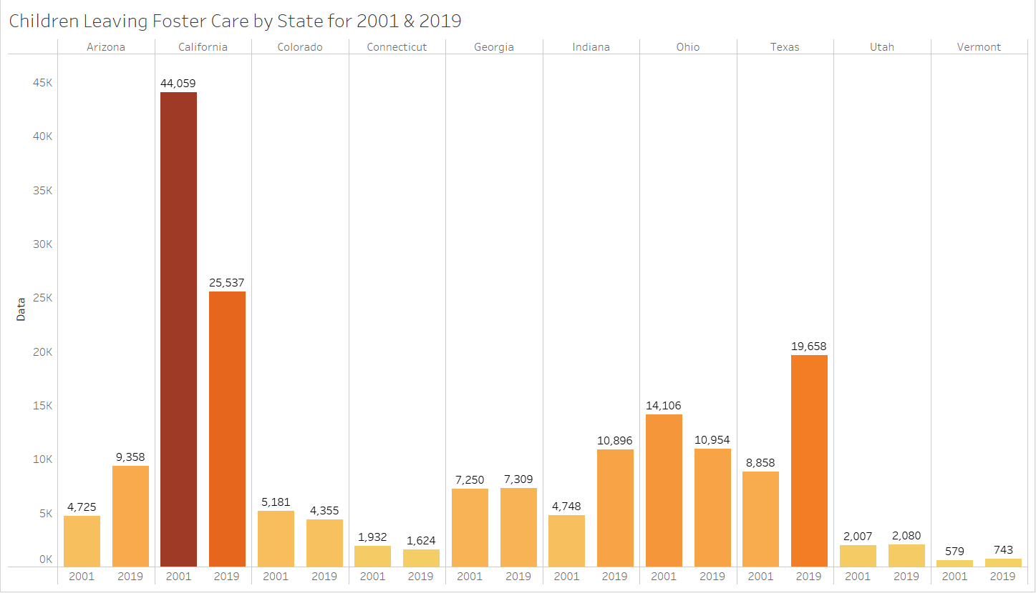
Evaluation Question 1: Do the children leaving Foster Care have an influence on the juvenile incarceration numbers by state?
Notes:
Do the children leaving foster care have an influence on the juvenile incarceration numbers by state?
a. The quick and easy answer would be no. With the limited data we have found there is no correlation
b. There is no significance influence from children leaving foster care to juvenile incarceration numbers by state.
c. Without considering age range, children leaving foster care has decreased slightly throughout these 10 years.
d. We can see that the number of children leaving foster care is not a one-to-one comparison to juvenile incarceration.

Slide 14

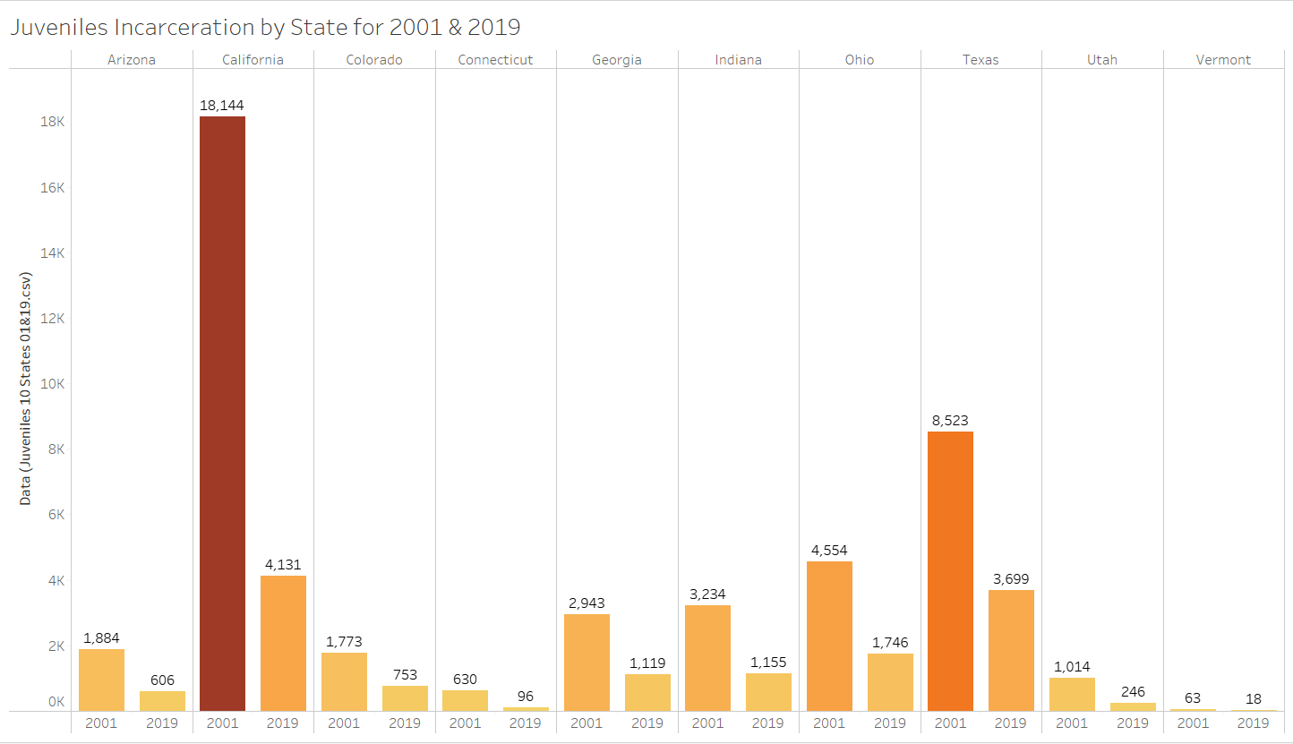
Evaluation Question 1: Do the children leaving Foster Care have an influence on the juvenile incarceration numbers by state?
Notes:
Do the children leaving foster care have an influence on the juvenile incarceration numbers by state?
a. The quick and easy answer would be no. With the limited data we have found there is no correlation
b. There is no significance influence from children leaving foster care to juvenile incarceration numbers by state.
c. We can see that the number of children leaving foster care is not a one-to-one comparison to juvenile incarceration.
d. Without considering age range, children leaving foster care has decreased slightly throughout these 10 years.

Slide 15
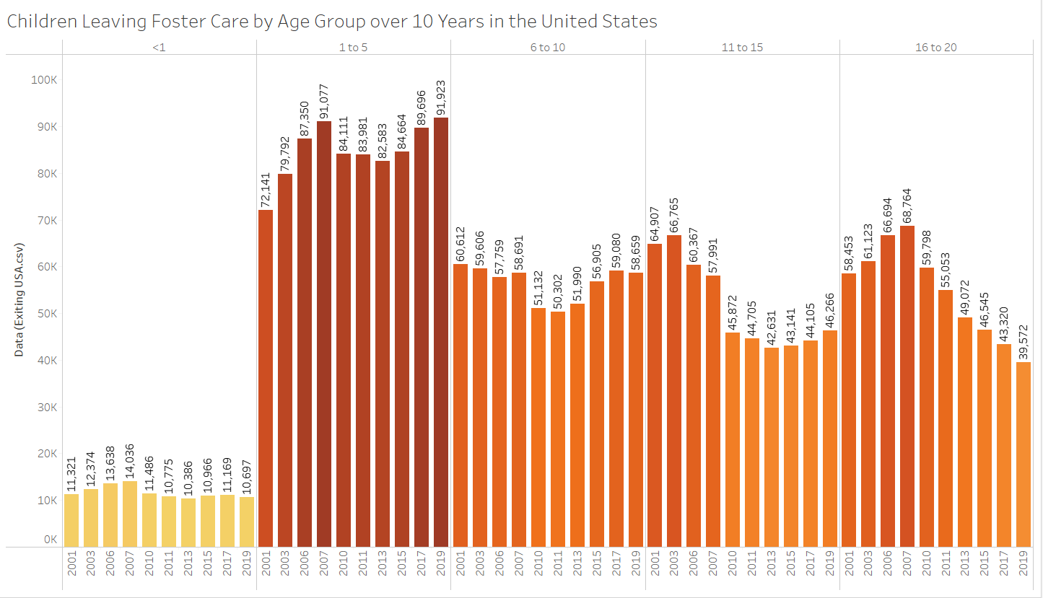
Evaluation Question 2: Does the age group of children leaving Foster Care in the United States have an influence on juvenile incarceration?
Notes:
2. Does the age group of children leaving Foster Care have an influence on juvenile incarceration?
a. There is also no influence from the age group of children exiting foster care on the juvenile incarceration numbers
b. We can see that from 2001 to 2019 the number of children in detention centers has significantly decreased
c. We can also see that the number of children leaving foster care has in the case for the 1 to 5 range age group has increased for the most part. While the other age groups has been steady throughout the 10 years
d. The age groups that would most likely have a link to juvenile incarceration is the hardest to pin down
e. Since not all states will allow children past the age of 18 to remain in foster care, there is no uniform way to track if these children are leaving foster care due to adoption or aging out of the system.
f. Since the datasets have the age ranges group differently, it makes a one-to-one comparison difficult.

Slide 16

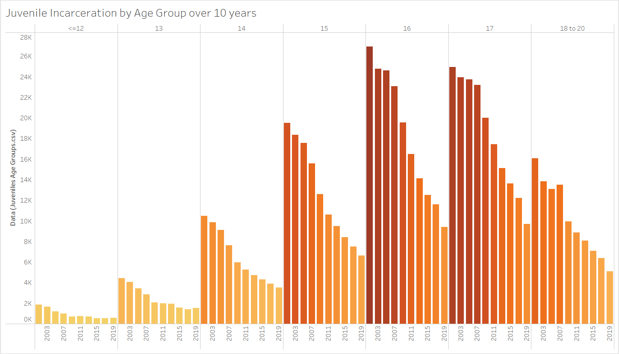
Evaluation Question 2: Does the age group of children leaving Foster Care in the United States have an influence on juvenile incarceration?
Notes:
2. Does the age group of children exiting Foster Care have an influence on juvenile incarceration?
a. There is also no influence from the age group of children exiting foster care on the juvenile incarceration numbers
b. We can see that from 2001 to 2019 the number of children in detention centers has significantly decreased
c. We can also see that the number of children leaving foster care has in the case for the 1 to 5 range age group has increased for the most part. While the other age groups has been steady throughout the 10 years
d. The age groups that would most likely have a link to juvenile incarceration is the hardest to pin down
e. Since not all states will allow children past the age of 18 to remain in foster care, there is no uniform way to track if these children are leaving foster care due to adoption or aging out of the system.
f. Since the datasets have the age ranges group differently, it makes a one-to-one comparison difficult.

Slide 17
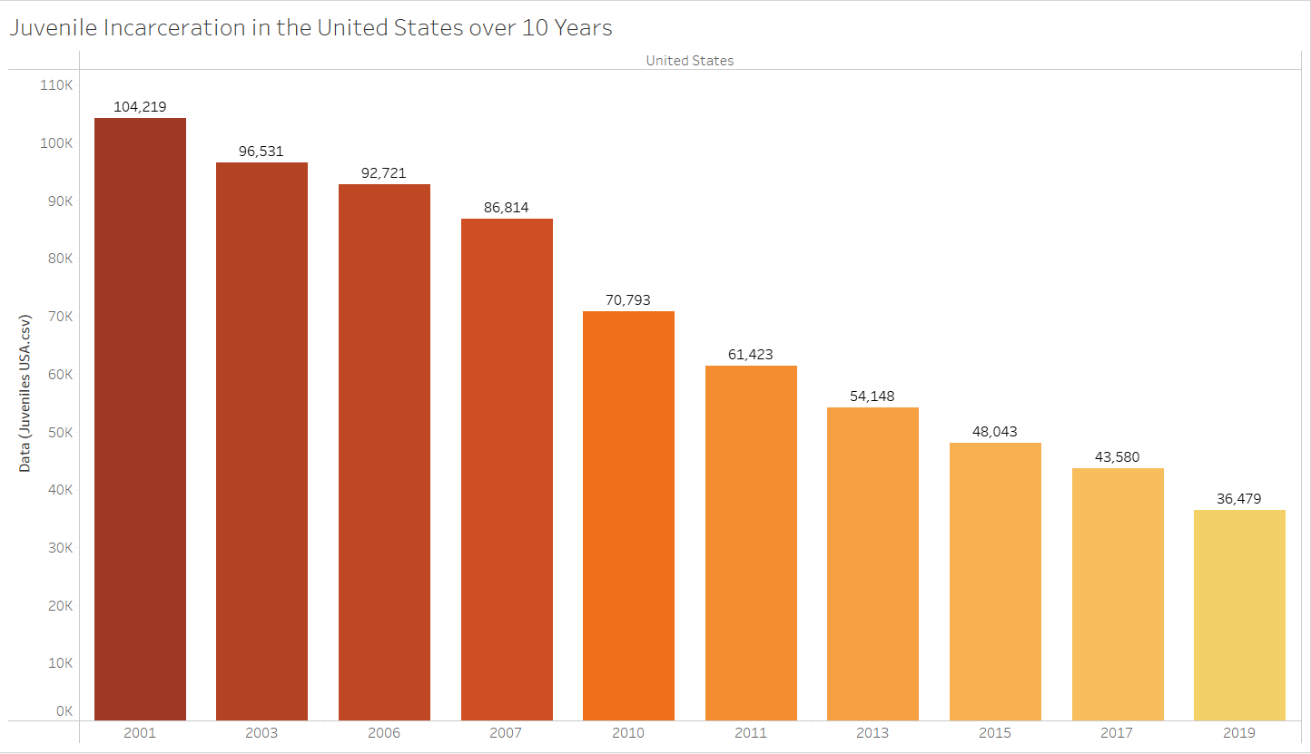
Evaluation Question 2: Does the age group of children leaving Foster Care in the United States have an influence on juvenile incarceration?
Notes:
2. Does the age group of children exiting Foster Care have an influence on juvenile incarceration?
a. There is also no influence from the age group of children exiting foster care on the juvenile incarceration numbers
b. We can see that from 2001 to 2019 the number of children in detention centers has significantly decreased
c. We can also see that the number of children leaving foster care has in the case for the 1 to 5 range age group has increased for the most part. While the other age groups has been steady throughout the 10 years
d. The age groups that would most likely have a link to juvenile incarceration is the hardest to pin down
e. Since not all states will allow children past the age of 18 to remain in foster care, there is no uniform way to track if these children are leaving foster care due to adoption or aging out of the system.
f. Since the datasets have the age ranges group differently, it makes a one-to-one comparison difficult.

Slide 18
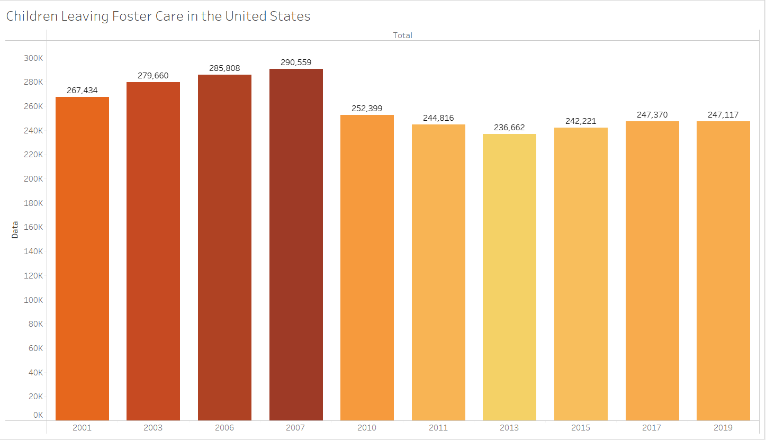
Evaluation Question 2: Does the age group of children leaving Foster Care in the United States have an influence on juvenile incarceration?
Notes:
2. Does the age group of children exiting Foster Care have an influence on juvenile incarceration?
a. There is also no influence from the age group of children exiting foster care on the juvenile incarceration numbers
b. We can see that from 2001 to 2019 the number of children in detention centers has significantly decreased
c. We can also see that the number of children leaving foster care has in the case for the 1 to 5 range age group has increased for the most part. While the other age groups has been steady throughout the 10 years
d. The age groups that would most likely have a link to juvenile incarceration is the hardest to pin down
e. Since not all states will allow children past the age of 18 to remain in foster care, there is no uniform way to track if these children are leaving foster care due to adoption or aging out of the system.
f. Since the datasets have the age ranges group differently, it makes a one-to-one comparison difficult.

Slide 19

Summary
For both Evaluation Questions, we found no significant correlation.
There is no influence on the Juvenile incarceration numbers by either state or age group.
The trend for juvenile incarceration was reduced by more than a third from 2001 to 2019
Children leaving Foster Care did decrease but only slightly by 15 percent from it peak in 2007 to 2019
2007 was the peak for the total number of children leaving Foster Care. More research needs to be done to determine if there is a cause to this peak and why there is a decline in the years after.

Slide 20

Conclusion
In Conclusion we have come to find that even though the data we have discovered has been very beneficial in answering some of our questions regarding the number of children leaving Foster Care and the number of children in the juvenile justice system, it has been discovered that the correlation between the two is not apparent.
We believe that in order to properly ascertain what needs to be done we must first have more detailed data that is accessible to the public without releasing the personal information of any foster children, juvenile detention center inmates, as well as prison inmates.
All government agencies involved in such work should have more data scientist and software engineers working in the field of juvenile justice, social work, and our prison system in order to provide more exact numbers to the percentages of children in Foster Care that are in juvenile detention as well as having more data on the adults in the prison system that have ever spent time in Foster Care.
We know for sure that if more data were available, it can bring more awareness to the Foster care to Prison Pipeline and pave the way for more government and state agencies to create programs that will assist children who age out of the system and create programs that can possibly aid in deterring criminal behavior in children who are at risk for falling into the justice system.

Slide 21

Questions?

